Slide 1
N-ary Trees

Slide 2
Outline
This topic quickly looks at a generalization of a binary tree, where each node has up to N children
Definition
Perfect N-ary trees
Complete N-ary trees
Implementation using templates

Slide 3
N-ary Trees
5.4.1
One generalization of binary trees are a class of trees termed N-ary trees:
A tree where each node had N sub-trees, any of which may be may be empty trees

Slide 4
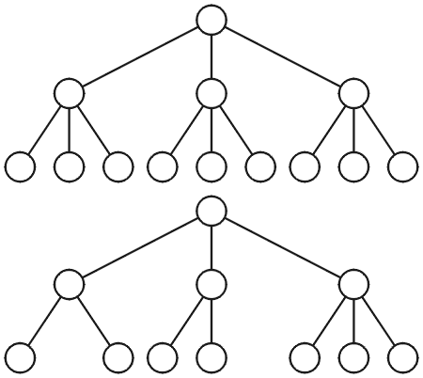
Ternary Trees
5.4.1
Examples of a ternary (3-ary) trees
We don’t usually indicate empty sub-trees

Slide 5
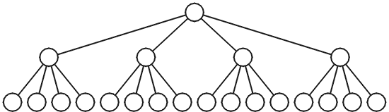
Quaternary Trees
5.4.1
Example of a perfect quaternary (4-ary) tree
Under certain conditions, the number of operations required may be slightly fewer with quaternary trees (e.g., with heaps)
The asymptotic behaviour is similar

Slide 6
Perfect N-ary Trees
5.4.2.1
Each node can have N children
The number of nodes in a perfect N-ary tree of height h is
1 + N + N² + N³ ⋅⋅⋅ + N^{h}
This is a geometric sum, and therefore, the number of nodes is

Slide 7
Perfect N-ary Trees
5.4.2.2
Solving this equation for h, a perfect N-ary tree with n nodes has a height given by

Slide 8
Perfect N-ary Trees
5.4.2.2
We note, however, that log_{N}(nN) – 1 = log_{N}(n), hence, we may postulate that log_{N}(n) should be an equally good approximation

Slide 9
N-ary Trees
5.4.2.3
Recall that the height for perfect binary tree is approximately lg(n)
Therefore, if the height of an N-ary tree is log_{N}(n), the ratio of the heights is:

Slide 10
N-ary Trees
5.4.2.3
Therefore:
The height of a perfect quaternary tree is approximately ½ the height of a perfect binary tree with approximately the same number of nodes
The height of a perfect 16-ary tree is approximately ¼ the height of a perfect binary tree with the same number of nodes

Slide 11
Complete N-ary Trees
5.4.2.4
A complete N-ary tree has height
Like complete binary trees, complete N-ary trees can also be stored efficiently using an array:
Assume the root is at index 0
The parent of a node with index k is at location
The children of a node with index k are at locations
kN + j
for j = 1, …, N

Slide 12
Implementation of N-ary Trees
5.4.3
The “obvious” implementation of N-ary trees may be something like:
# include <algorithm>
template <typename Type>
class Nary_tree {
private:
Type node_value;
int N;
Nary_tree **children;
public:
Nary_tree( Type const &, int = 2 );
// ...
};
template <typename Type>
Nary_tree<Type>::Nary_tree( Type const &e, int n ):
node_value( e ),
N( std::max( 2, n ) ),
children( new *Nary_tree[N] ) {
for ( int i = 0; i < N; ++i ) {
children[i] = nullptr;
}
}

Slide 13
Implementation of N-ary Trees
5.4.3
Problems with this implementation:
Requires dynamic memory allocation
A destructor is required to delete the memory
No optimizations possible
Dynamic memory allocation may not always be available (embedded systems)
Solution?
Specify N at compile time...

Slide 14
N-ary Trees with Template Parameters
5.4.3
#include <algorithm>
template <typename Type, int N>
class Nary_tree {
private:
Type node_value;
Nary_tree *children[std::max(N, 2)]; // an array of N children
public:
Nary_tree( Type const & = Type() )
// ...
};
template <typename Type, int N>
Nary_tree<Type, N>::Nary_tree( Type const &e ):node_value( e ) {
for ( int i = 0; i < N; ++i ) {
children[i] = nullptr;
}
}

Slide 15
N-ary Trees with Template Parameters
5.4.3
Sample code using this class:
Nary_tree<int, 4> i4tree( 1975 ); // create a 4-way tree
std::cout << i4tree.value() << std::endl;

Slide 16
N-ary Trees
5.4.3
Because the size of the array (the 2nd template parameter) is specified at compile time:
The compiler can make certain optimizations
All memory is allocated at once
Possibly even on the stack at compile time
No destructor required

Slide 17
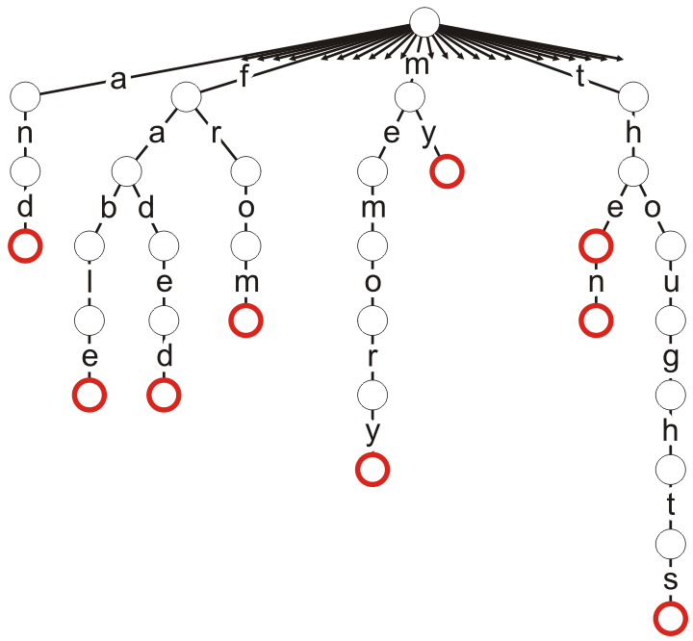
Applications
5.4.4
One application of an 26-ary trees is a trie where the root represents the start of each valid word, and the different sub-trees represent next letters in valid words
Consider the words in the phrase
“The fable then faded from my thoughts and memory.”
All 26 sub-trees are only shown for the root node, but all nodes have 26 sub-trees
Some nodes are marked as terminal indicating the end of a valid word
These terminal points could be used to store a list of all places in a document where the word occurs
Consider the ultimate index to a book

Slide 18
Summary
An N-ary tree is similar to a binary tree, however, each node can have up to N children
A binary tree has a height approximately log₂(N) times the height of an N-ary tree containing the same number of nodes

Slide 19
Reference
[1] Cormen, Leiserson, and Rivest, Introduction to Algorithms, McGraw Hill, 1990, §5.5.3, p.94-96.

Slide 20
Usage Notes
These slides are made publicly available on the web for anyone to use
If you choose to use them, or a part thereof, for a course at another institution, I ask only three things:
that you inform me that you are using the slides,
that you acknowledge my work, and
that you alert me of any mistakes which I made or changes which you make, and allow me the option of incorporating such changes (with an acknowledgment) in my set of slides
Sincerely,
Douglas Wilhelm Harder, MMath
dwharder@alumni.uwaterloo.ca

